Slide 1
Employee Data Analysis using Excel
STUDENT NAME: Janani . T
REGISTER NO: 312208387 , asunm1330313308387
DEPARTMENT: Accounting and Finance
COLLEGE: CHELLAMMAL WOMEN ‘S COLLEGE

Slide 2

PROJECT TITLE
Employee Performance Analysis using Excel

Slide 3


AGENDA
Problem Statement
Project Overview
End Users
Our Solution and Proposition
Dataset Description
Modelling Approach
Results and Discussion
Conclusion
3/21/2024 Annual Review

Slide 4

PROBLEM STATEMENT
Employee performance data analysis is used in many ways.
We can use the attendance data , performance level data and gender to Analysis the employee .
This is useful for give motivation, incentives and advice to the employees .
Collecting the data and analysis the overall performance of employee is the primary goal is to identify strengthen and area to improve of employee.
Discuss the Challenge of Managing and enhancing the employee

Slide 5

PROJECT OVERVIEW
Using Excel features like filter , charts , conditional formatting and so on. Analysis the given employee information such as name , gender , performance level in this Project
Selecting the required information and filter the blank space to create a pivot chart , bar diagram.
Briefly describe the key stages of the project:
Data collection, analysis, modeling, and solution implementation

Slide 6

WHO ARE THE END USERS?
Managers
HR department
Supervisors
Organization
Executives
Leaders

Slide 7

OUR SOLUTION AND ITS VALUE PROPOSITION
Conditional formatting – missing value
Filter – remove
Formula – performance level
Pivot – summary
Graph – data visualization

Slide 8
Dataset Description
Employee Data set = naan mudhalvan portal
26 features = 9 features.
9 features :
Email Id
First name
Last name
Starting date
Exit date
Gender
Type of business unit
Performance rating
Performance level

Slide 9

THE "WOW" IN OUR SOLUTION
Using formulas to find performance level
Performance level =IFS(Z8>=5,”very high”,z8>=4,”high”,
Z8>=3,”med”,”true”,”low”)
3/21/2024 Annual Review
9

Slide 10
MODELLING
# DATA COLLECTION :
Collecting the data from naan Mudhalvan portal at edunet employee performance analysis using Excel
# DATA CLEARING:
Clearing the collected data by using Excel features and techniques like conditions forming for clear blank space, filtering for missing figures, using colors for selecting columns,
Using formulas for performance level of employee
# SELECTED INFORMATION :
Employee first & last name , email ID , business unit , gender , performance rate & level .
# PIVOTAL CHART :
Selecting the columns by coloring and insert into pivotal chart and choose the row & columns , values .
# CHART :
Choosing the employee performance level , business type and gender into the bar charts , graph chart .
10

Slide 11
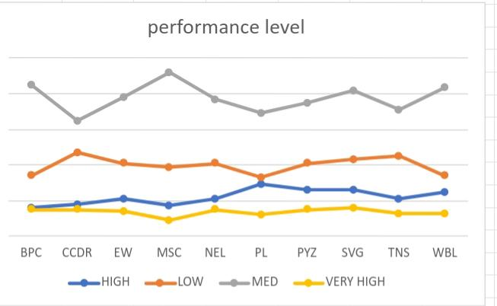
RESULTS
11

Slide 12
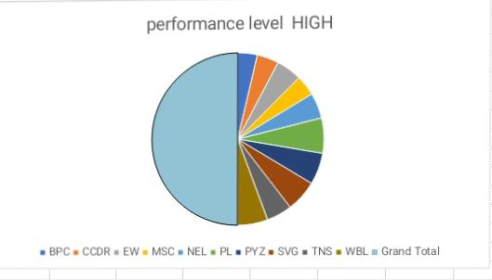
Results

Slide 13
Conclusion
Summarize the key takeaways:
@ The effectiveness of using Excel for employee performance analytics, the insights gained, and their potential impact on the organization.
@Emphasize the importance of continuous monitoring and data driven decision-making in improving workforce performance .
@Encourage the audience to consider implementing such a system in their organization to drive better results
THANK YOU

